Slide 1
State of HamWAN – Oct 2014
If you like the work you see here,
please support it by donating
https://www.hamwan.org/
Bart Kus <me@bartk.us>

Slide 2
Achievements from Year 1
A functional network covering Tumwater to Stanwood
Discovery of the best hardware available
Organizational and funding structure
Development of the right protocol stack
Creation of HamWAN Labs
Free publication of all research and tools
Link distance record of 100 miles

Slide 3
Achievements from Year 2
New 4100ft site (Haystack) near Sultan, WA
First solar-powered site ⤴
Direct Internet feed via Westin building
Queen Anne relay site (150Mbit!)
Finished Capitol Park site with all sectors (finally)
Created a self-service user portal
HamWAN Memphis Metro bootstrapped
New Tukwila Internet feed site coming up
Propagation experience gained over the summer, and it’s not good news

Slide 4

New Progeny Instantiated

Slide 5
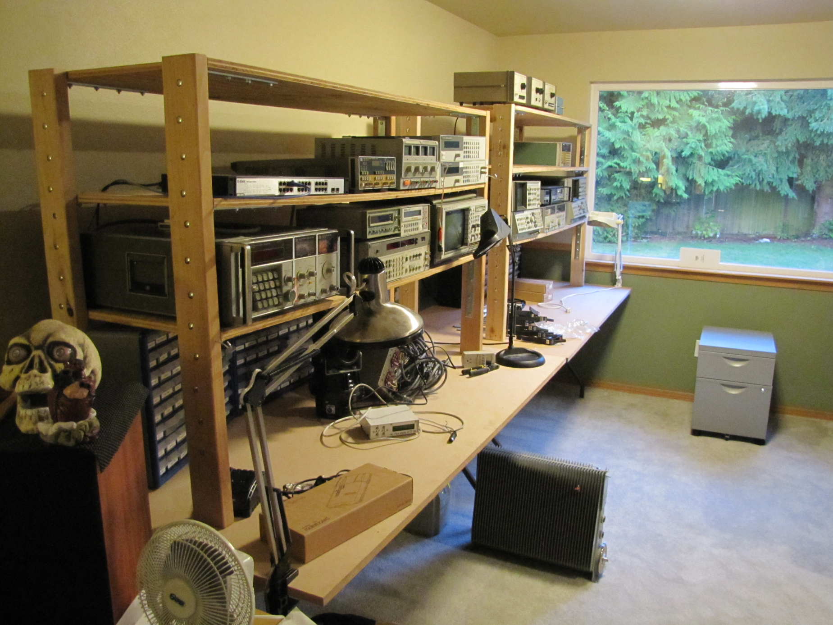
HamWAN Labs

Slide 6
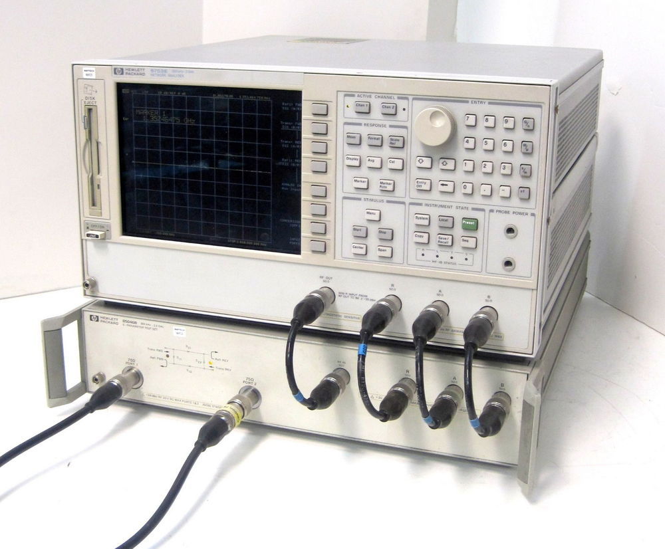
New HamWAN Labs Members
HP 8753E VNA
30kHz → 6GHz
Amplifiable test set
110dB dynamic range
VNA: $4,450 @ eBay (a steal!!! Item #
141415415274)
Test Set: $2,180 @ eBay

Slide 7
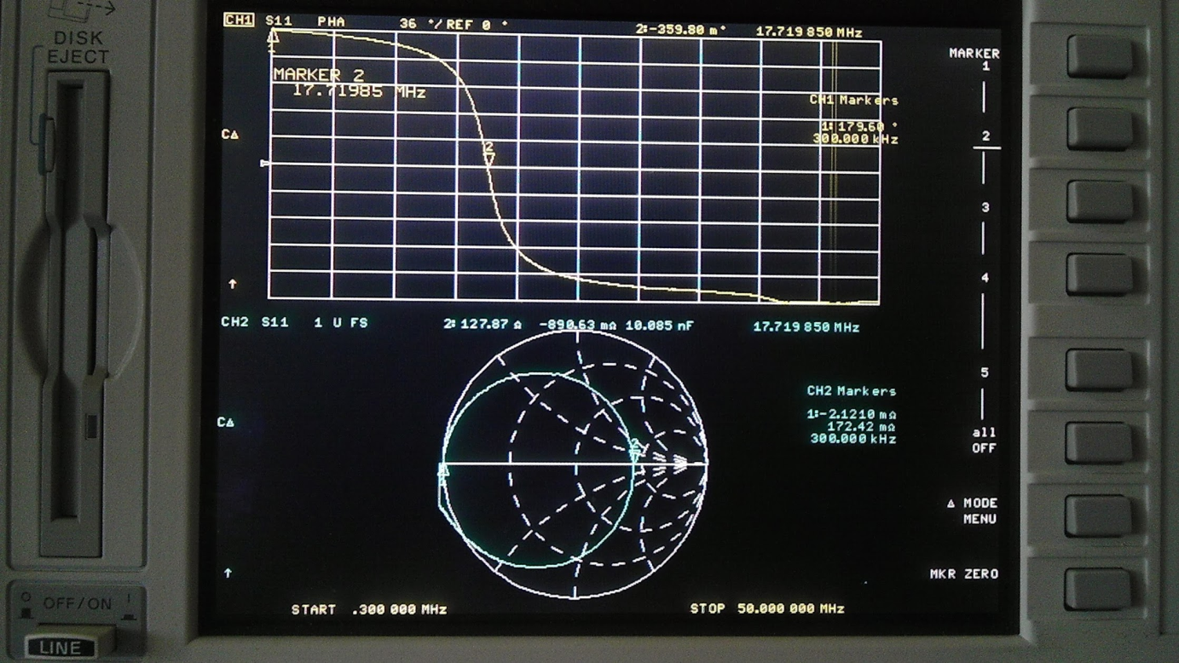
New HamWAN Labs Members
HP 8753E VNA
Sample response of a parallel LC resonator

Slide 8
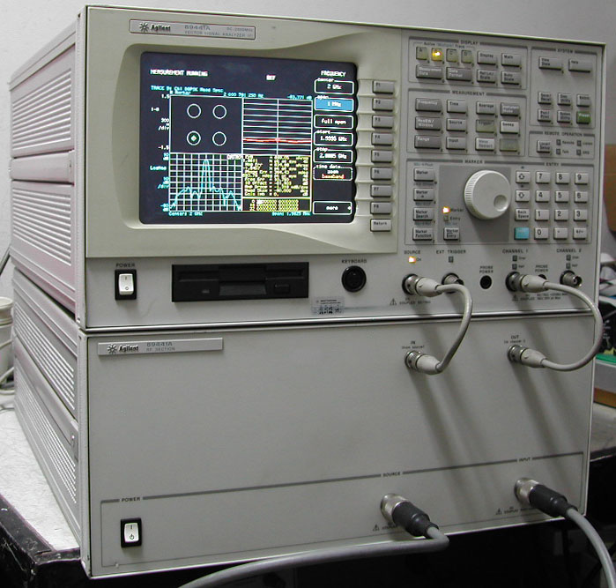
New HamWAN Labs Members
HP 89441A Vector Signal Analyzer
DC → 2.65GHz
Analyzes various digitally modulated signals
eg: Error Vector Magnitude
eg: Decode bit stream
Synthesizes arbitrary signals
eg: Transmit beacon frames
Uses broadband acquisition and frequency domain conversion
  It can really “zoom in” spectrally
  Never misses transients
A very complicated instrument
Analyzer: $900 @ eBay (presently overpriced)
RF Section: $500 @ eBay (presently overpriced)

Slide 9
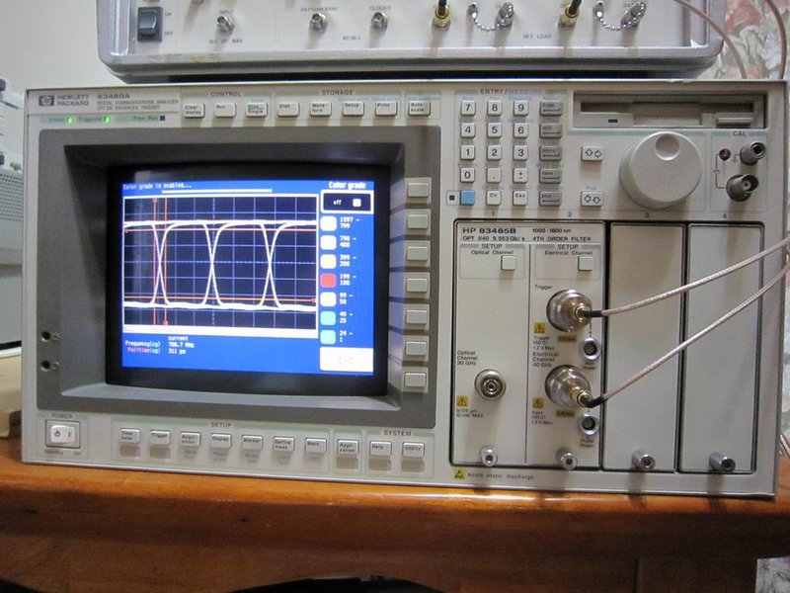
New HamWAN Labs Members
HP 83480A “Digital Communications Analyzer” aka Sampling Oscilloscope
83483A DC → 20GHz module
Upgradeable to 50GHz
Useful for viewing microwave signals in the time domain
Lets you directly interact with the speed of light
Lets you implement RADAR
Works on repetitive signals only
Frame: $380 @ eBay
Module: $900 @ eBay

Slide 10
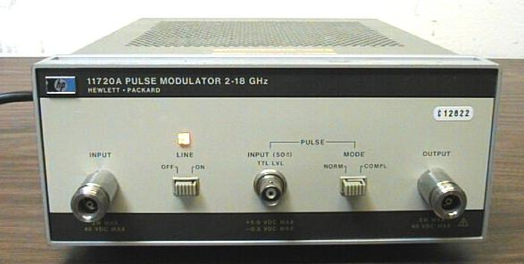
New HamWAN Labs Members
HP 11720A Pulse Modulator
2 → 18GHz
  Tested down to 900MHz
Lets you implement RADAR
Lets you use pulse measurement techniques in general
eg: Amplifier testing at full power but without burning up
$60 @ eBay

Slide 11
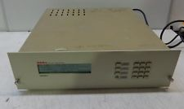
New HamWAN Labs Members
Odetics 425 Atomic Clock
Keeps all the instruments synchronized
GPS synchronized
  Globally phase-locked
$80 @ Puyallup Flea Market!

Slide 12
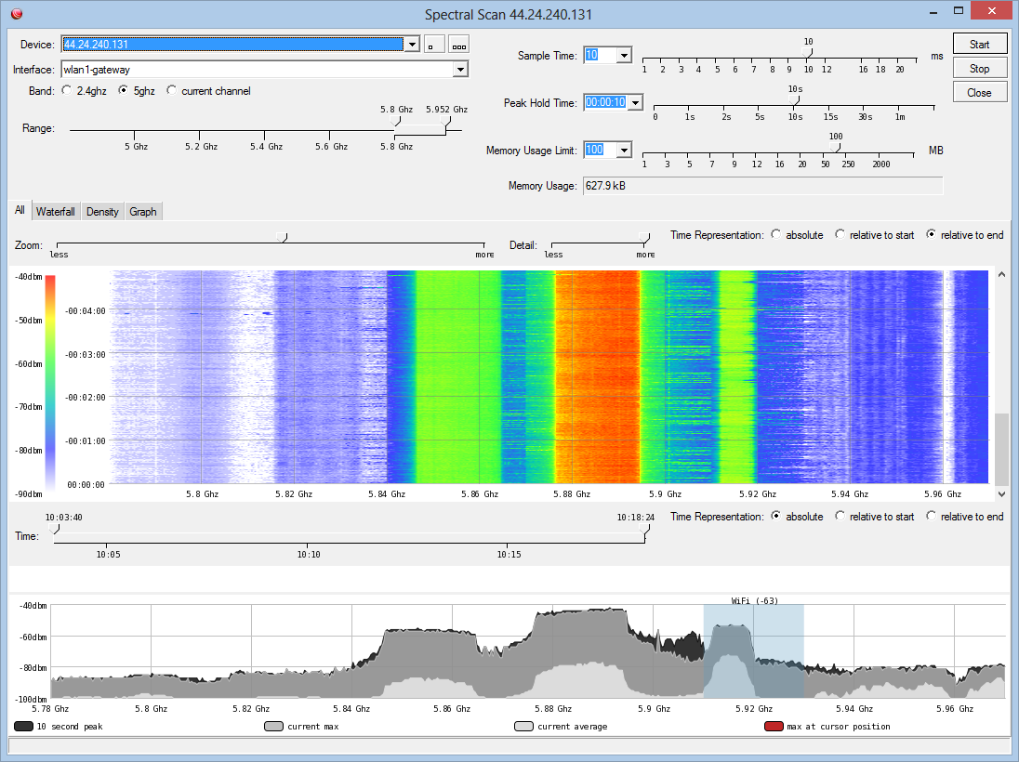
Upcoming Work

Slide 13
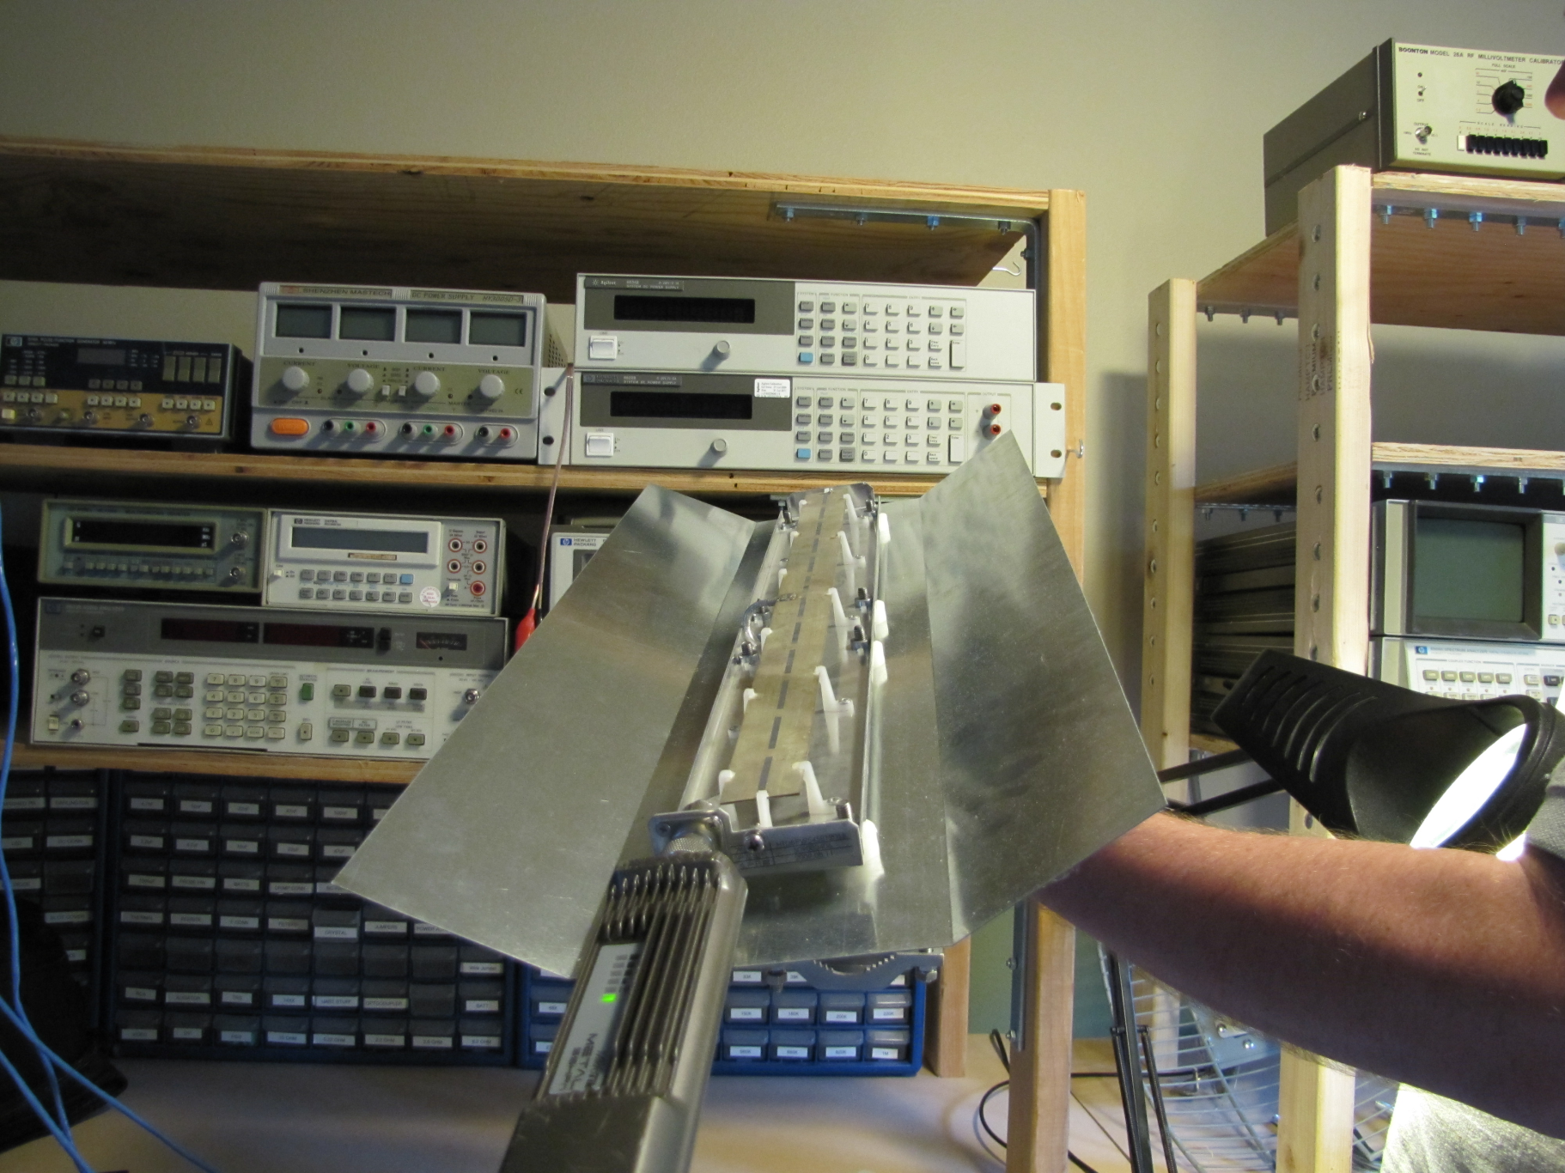
Upcoming Work

Slide 14
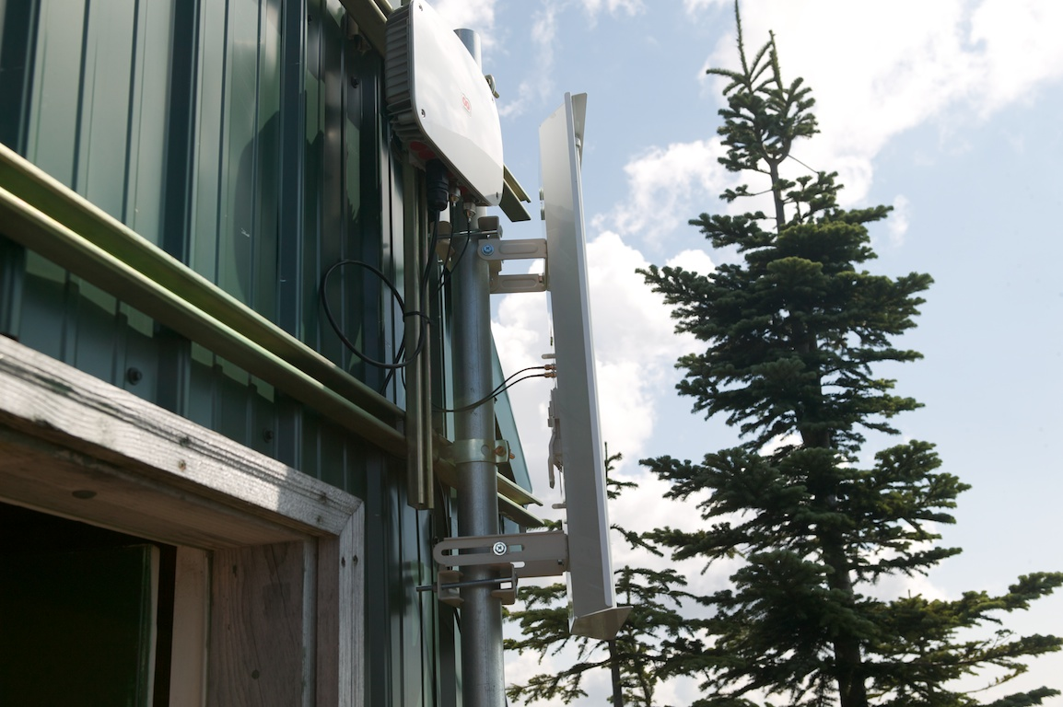
Haystack Implementation

Slide 15
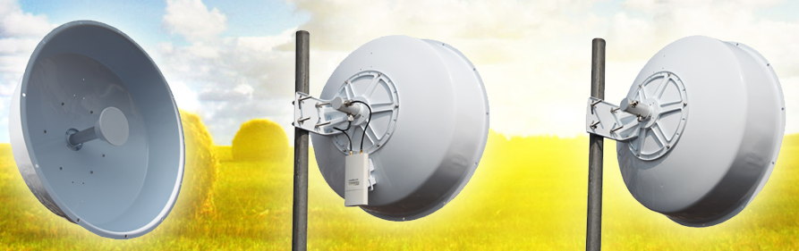
Upcoming Work

Slide 16
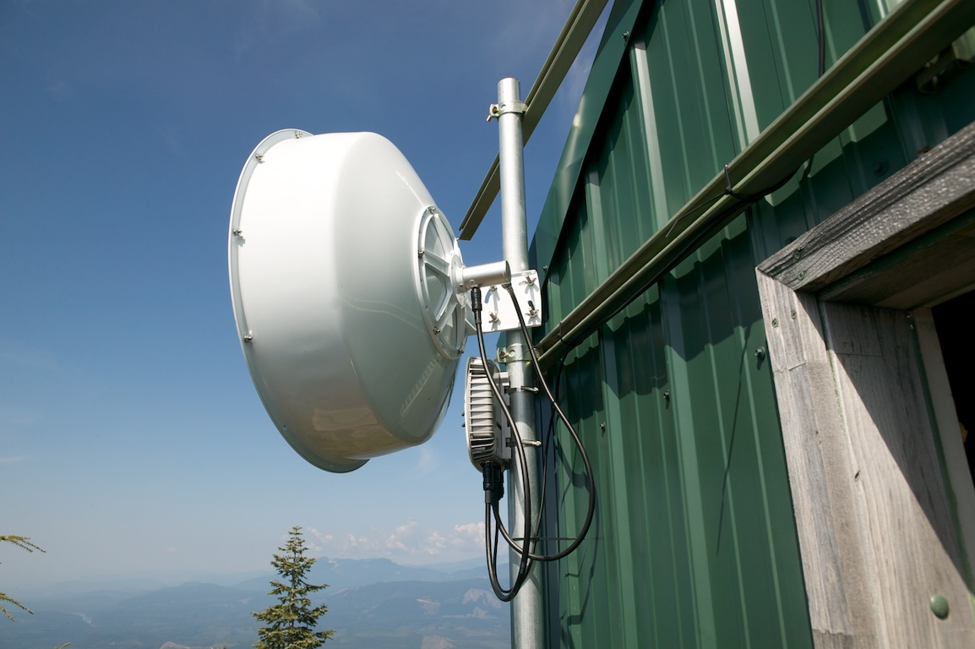
Haystack Implementation

Slide 17
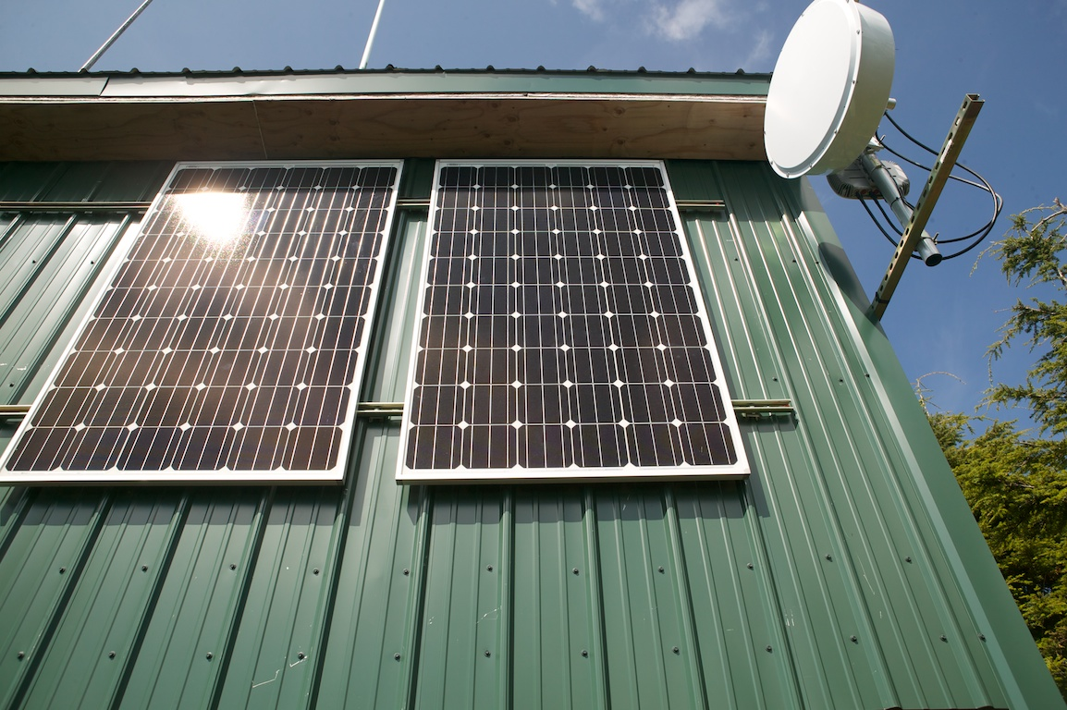
Haystack Implementation

Slide 18
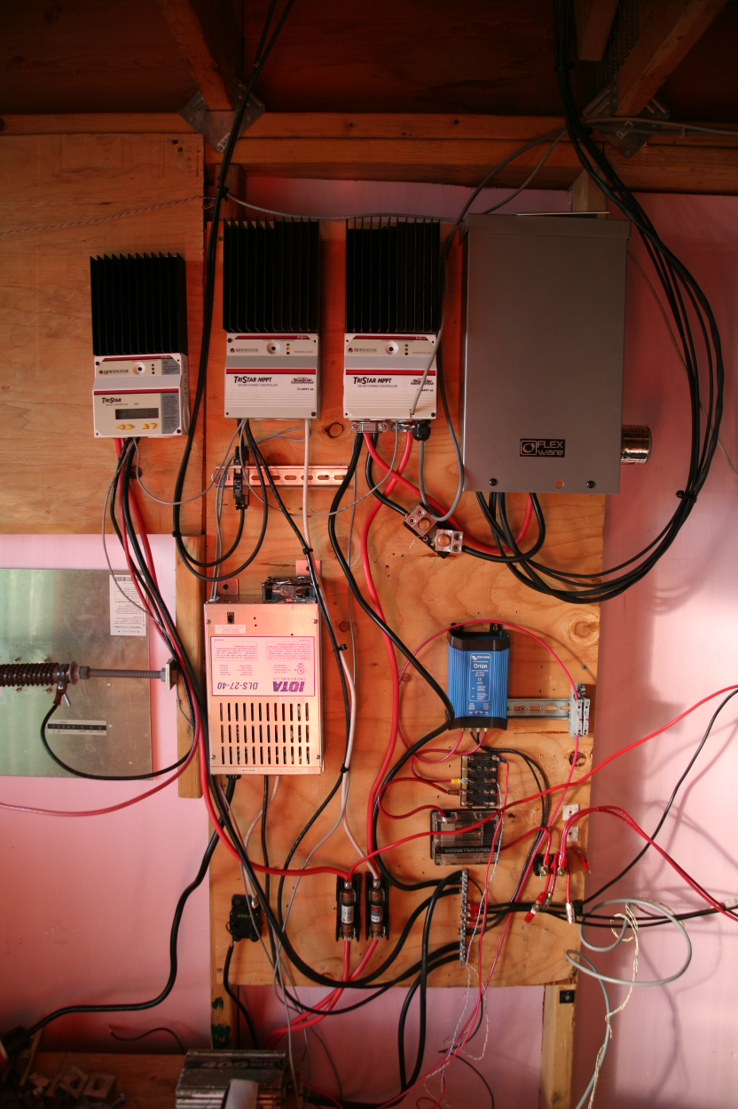
Haystack Implementation

Slide 19
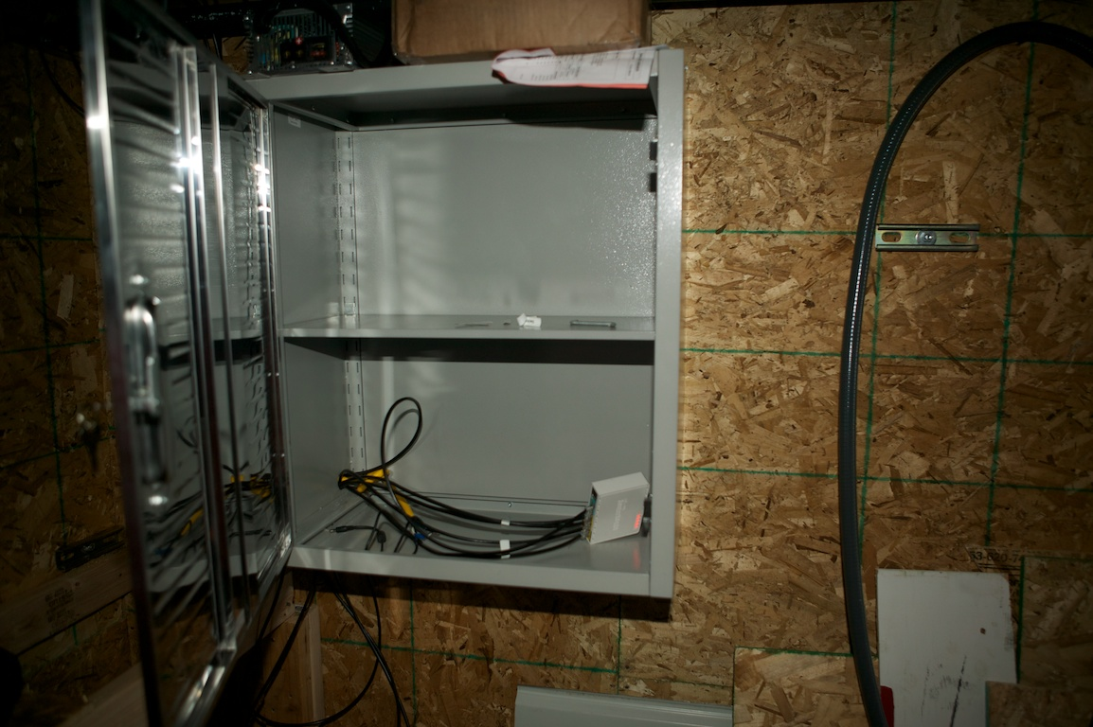
Haystack Implementation

Slide 20
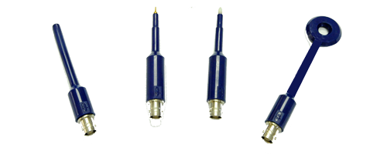
Upcoming Work
Nope, didn’t do any RF sniffing of the near-field.

Slide 21
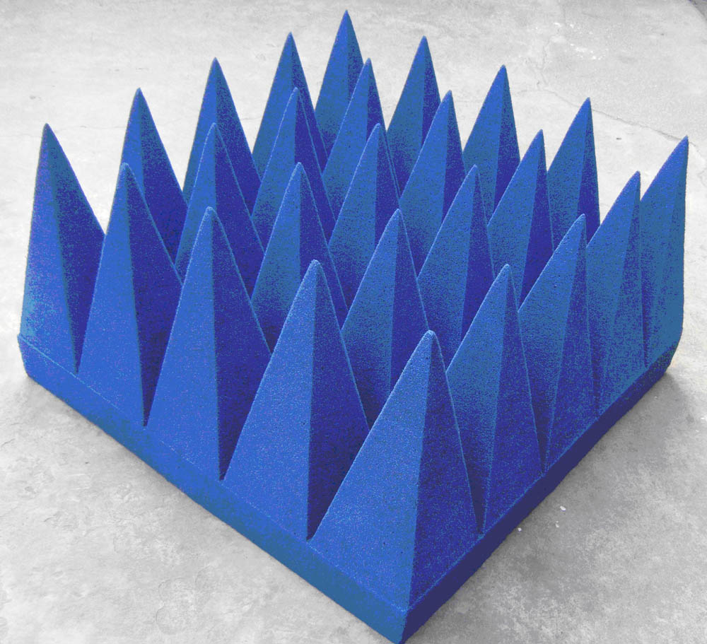
Upcoming Work

Slide 22
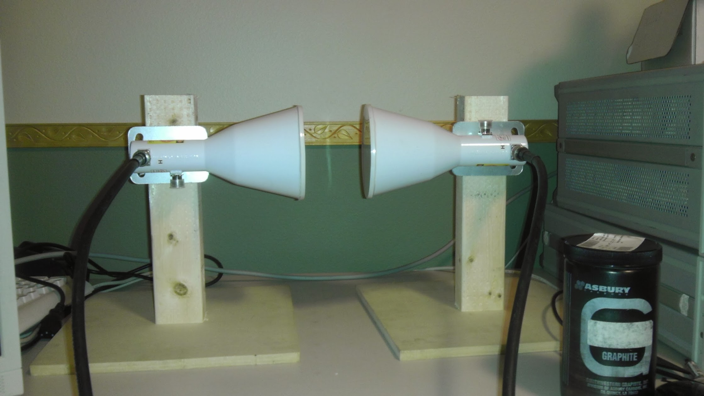
RF Absorber Implementation
Tried, and didn’t produce any acceptably useful absorbers.
It’s a multivariable problem and isn’t easy to get right.
Some attenuation and absorption was measured though!
Observations: https://plus.google.com/101764494655364903786/posts/5si97WBt5SQ

Slide 23
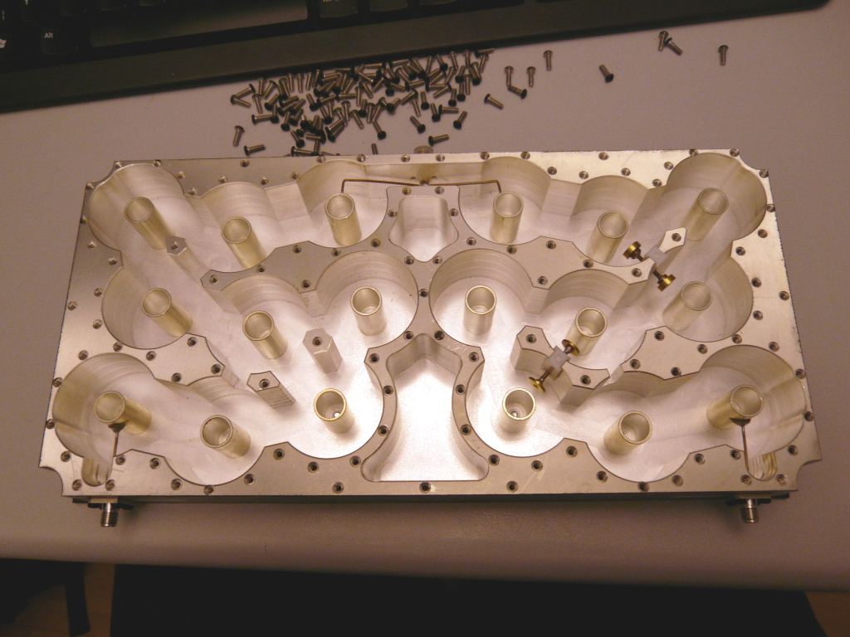
Upcoming Work - Report
Tested 3 filters. A notch filter performed wonderfully, but we don’t need notching.
Both bandpass filters had too much insertion loss and pass bandwidth.
5MHz @ 6GHz = 0.083%, which is very hard to do. Even 20MHz is still 0.33%.

Slide 24
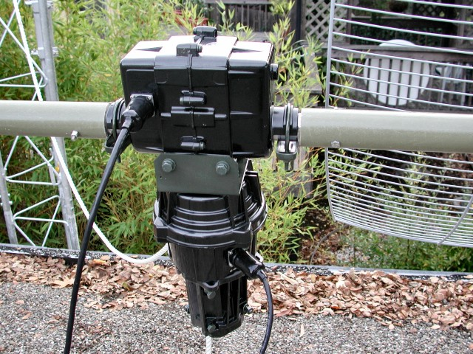
Upcoming Work

Slide 25
2-Axis Rotor Control Software

Slide 26
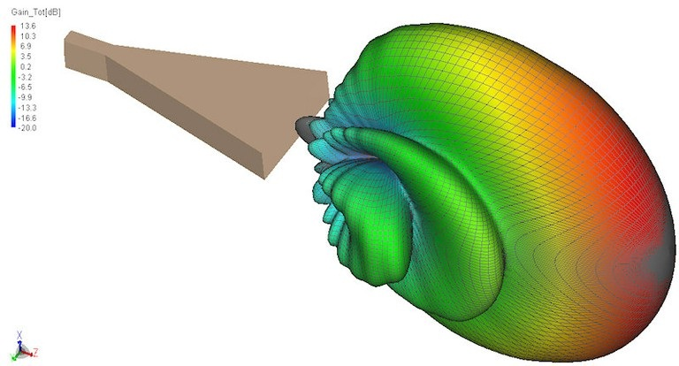
Radiation Measurement Software
Did not implement full signal acquisition and processing yet.
Have implemented instrument control and data read-out though.

Slide 27

Upcoming Work
+48.8dBm @ 6GHz
With 11.1dB gain
And 51% efficiency
For about $120
Anybody have a wire bonder?
TGF2032-2-20

Slide 28
Upcoming Work - Report
+48.8dBm @ 6GHz
With 11.1dB gain
And 51% efficiency
For about $120
Anybody have a wire bonder?
CANCELLED
No sense making more power if the self-interference is killing performance.
PS: Oh yeah, I have a wire bonder now.
TGF2032-2-20

Slide 29
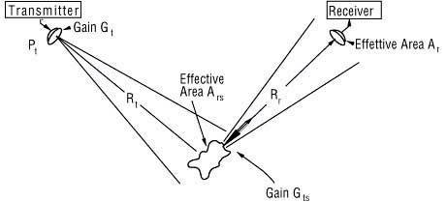
Upcoming Work

Slide 30
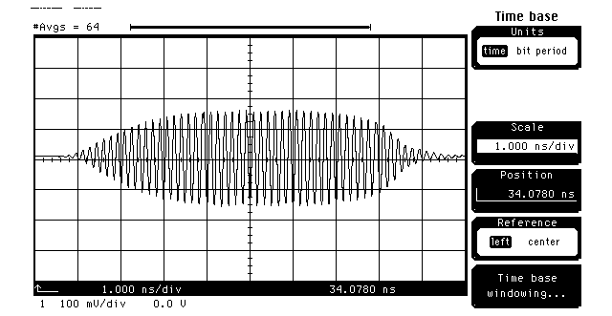
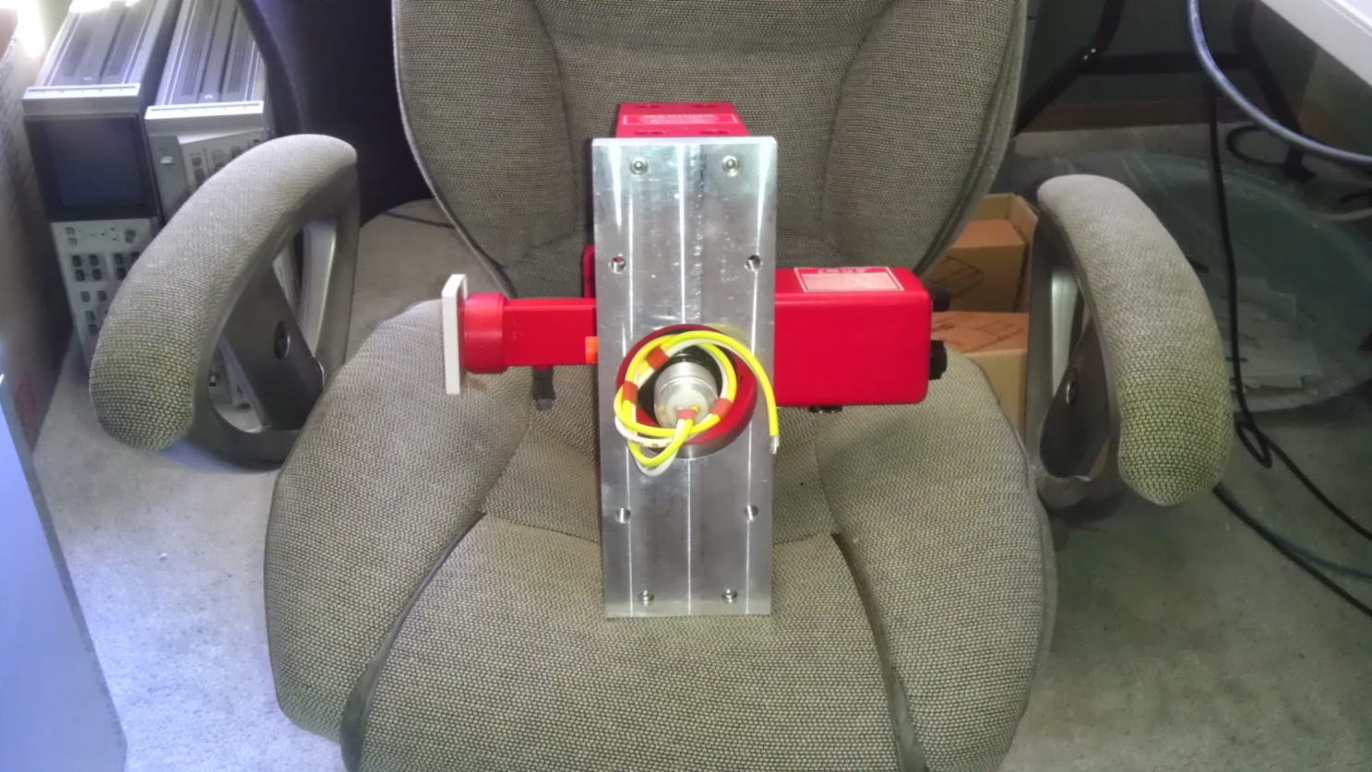
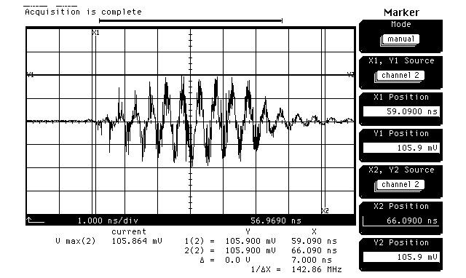
RADAR Techniques - Report
RADAR achieved in lab
Power amplifier (10W @ 6GHz) died before field testing could happen. ☹
I might have over-compensated a little and bought a 3.4kW 6GHz Klystron tube ($50 @ eBay):

Slide 31
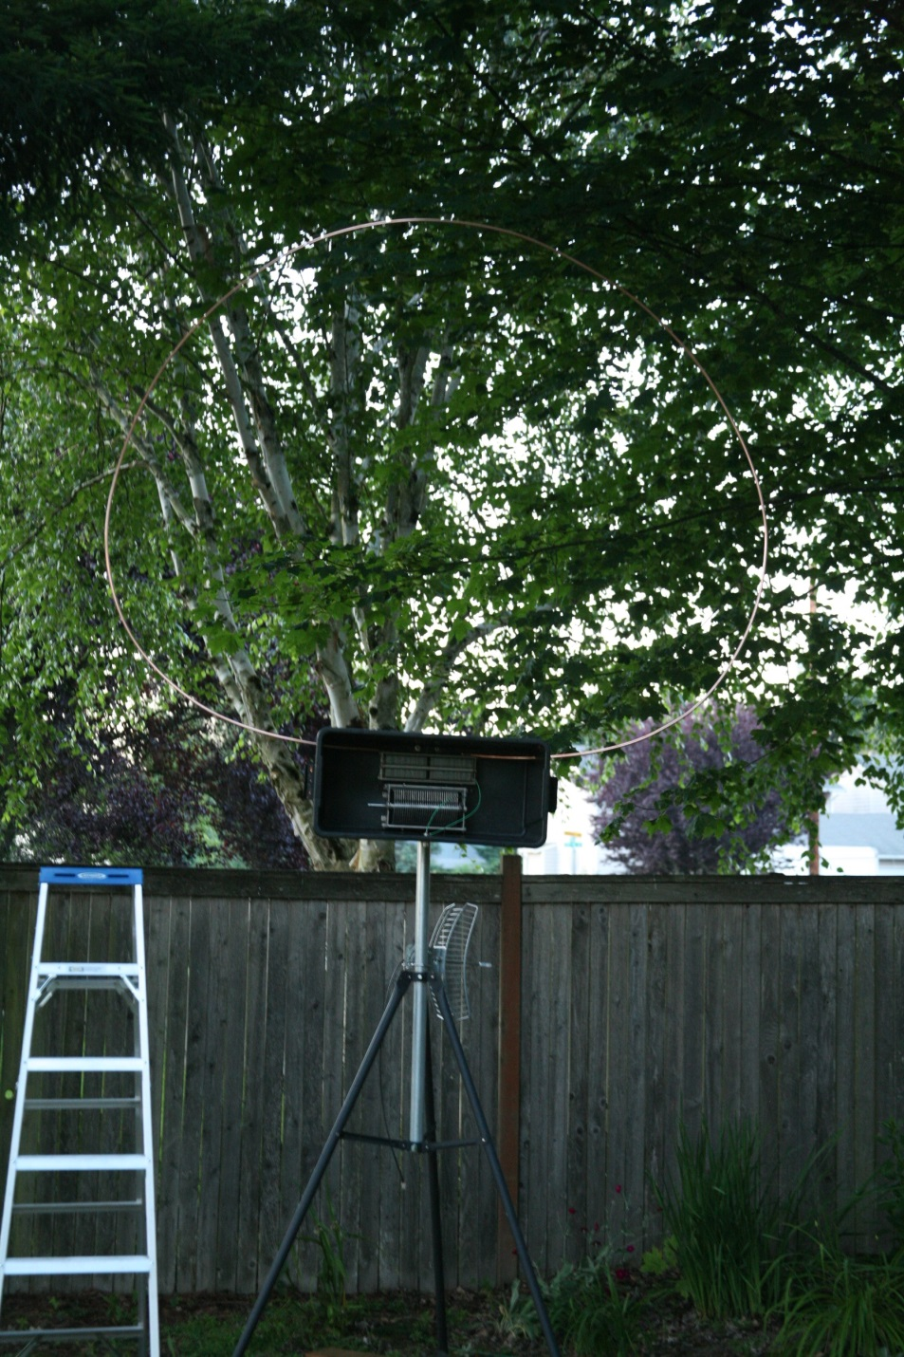
Upcoming Work (personal)
Finishing Loop Antenna Controller

Slide 32
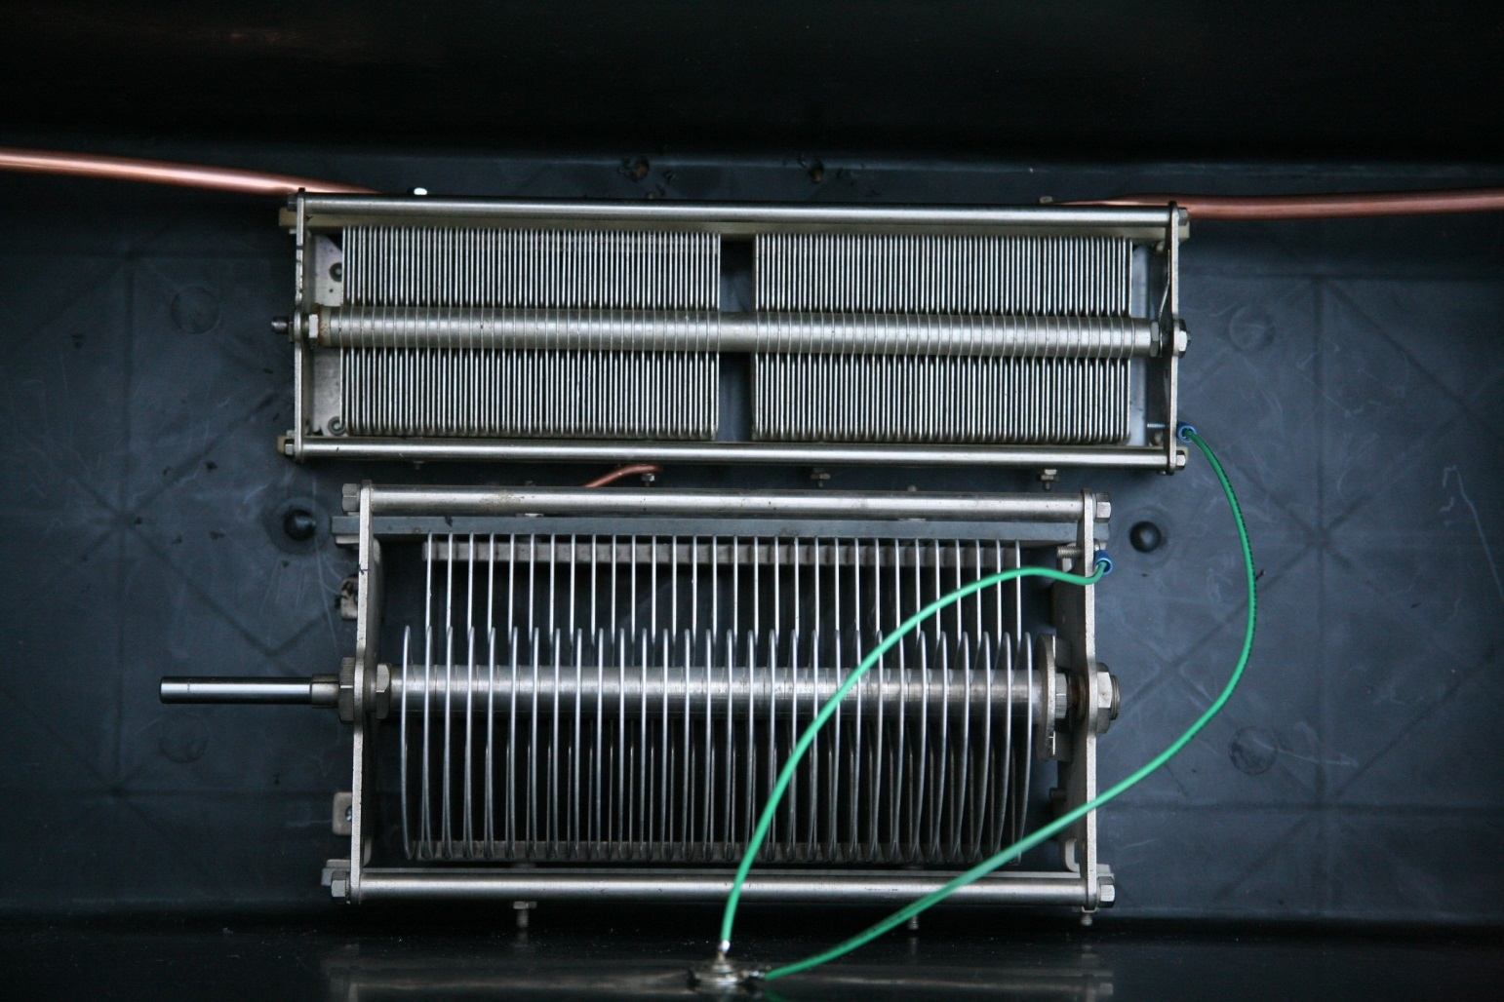
Upcoming Work (personal)
Finishing Loop Antenna Controller

Slide 33
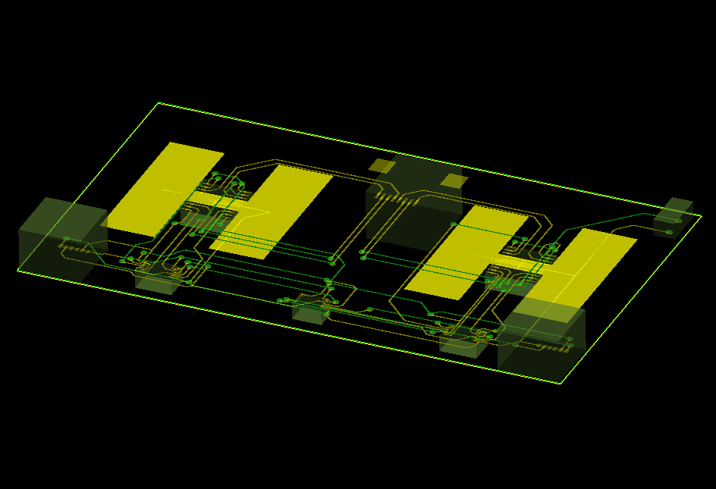
Upcoming Work (personal)
Finishing Loop Antenna Controller

Slide 34
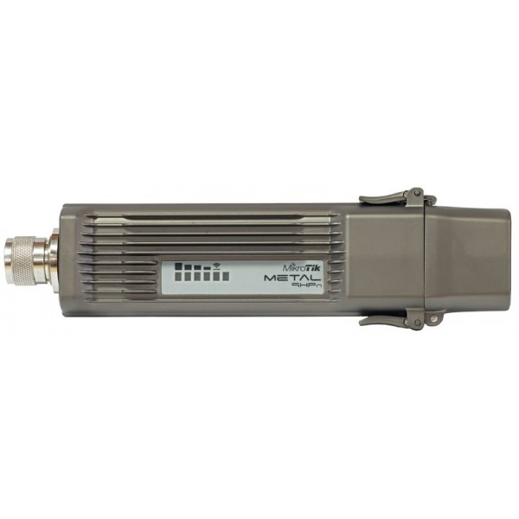
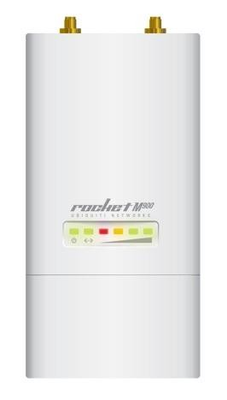
Upcoming Work
6GHz is proving difficult to use with trees
902MHz is the lowest amateur band without bandwidth or modulation rate limits
Couple new modems are available now:

Slide 35
Upcoming Work
Need a service that has deep penetration, even if it’s slower than 6GHz service
Would like to achieve mobile service
Filtering is easier: 5MHz @ 915MHz = 0.5%
Increase reliability with high power levels
General lack of bidirectional linear 902MHz power amplifiers on the market (~30W)
Started research on creating such a product, and will do development after loop antenna

Slide 36
Upcoming Work
Some 902MHz propagation testing through trees has been done, but more is needed
A sectorized service @ 902MHz will always be limited to 5MHz channels (only 26MHz total)
Making use of MIMO helps spectral efficiency
Questionable benefit for the mobile case

Slide 37
Upcoming Work (unchanged)
More software for network automation
More autonomous on-network services
Optimization of network stack
More sites / improved coverage
Better documentation to help others start HamWAN instances elsewhere
Optimize / enable end-user scenarios
Notes:
Services: IRC, Email, Wiki, VoIP, File Storage

Slide 38
Need Help On
Tukwila execution (insurance, contracts, purchasing, installation, configuration)
Trademark registration
  Someone decided they liked the name “HamWAN” so they bought hamwan.com for $3k from squatters and will be publishing their own non-HamWAN amateur network info on it
Network administration (debug / configure)
Plenty of other things…

Slide 39
Support This! (unchanged)
This project IS the modern frontier of ham radio
Fund this by donating on the website
Recruit engineers and spread the word to talented people about the work being done here
Provide sites to expand the network’s reach
Point other organizations to HamWAN

