Slide 1
Achievements from Year 1
A functional network covering Tumwater to Stanwood
Discovery of the best hardware available
Organizational and funding structure
Development of the right protocol stack
Creation of HamWAN Labs
Free publication of all research and tools
Link distance record of 100 miles

Slide 2
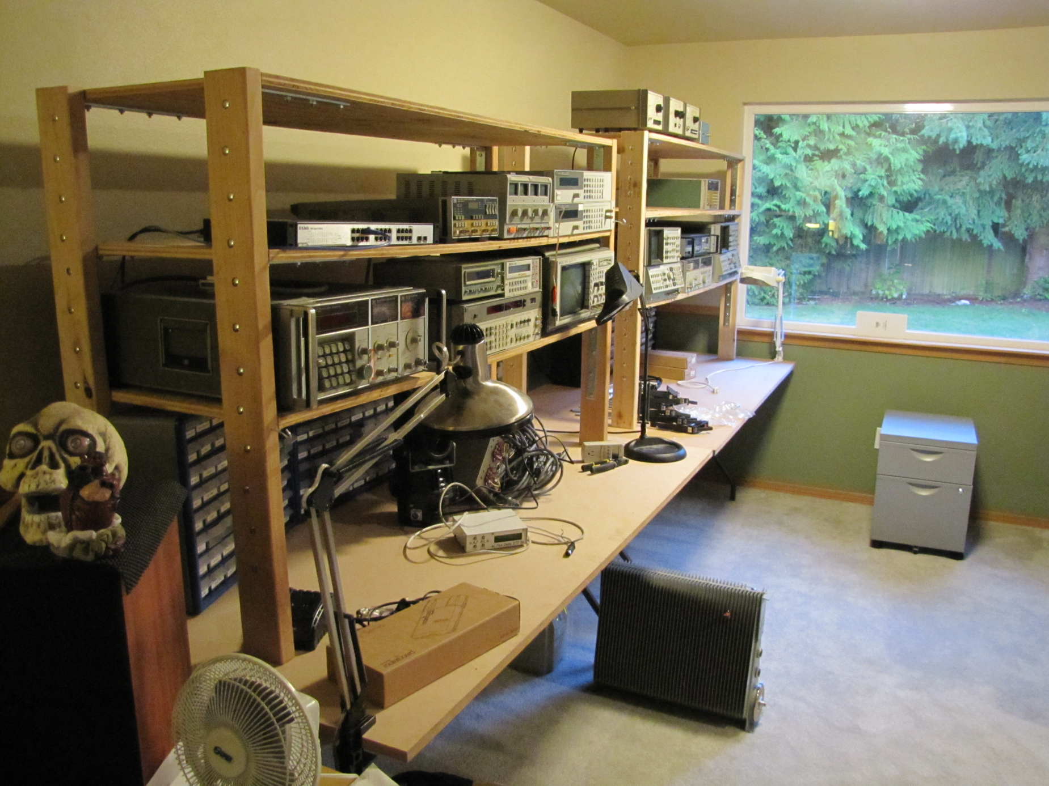
HamWAN Labs

Slide 3
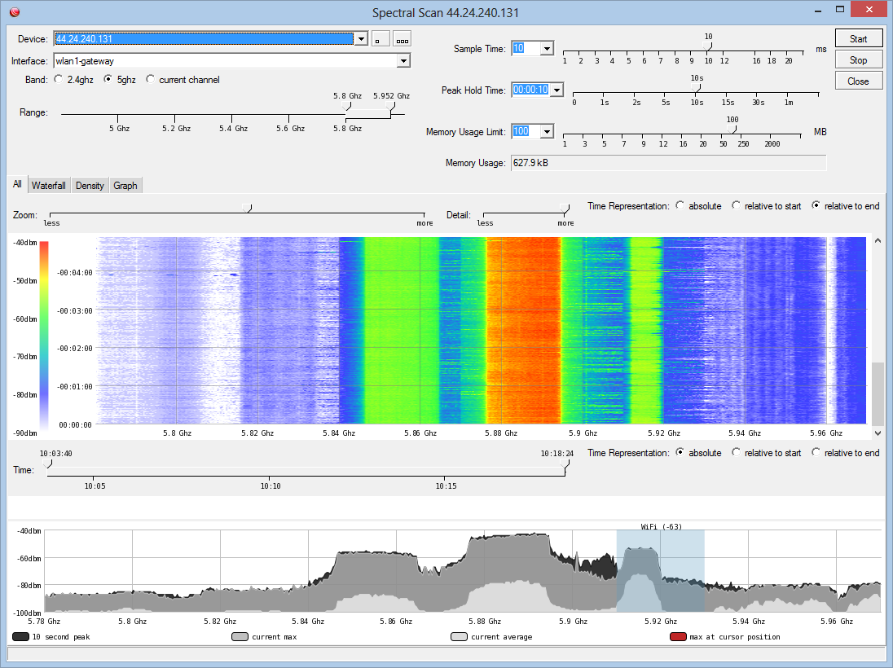
Upcoming Work

Slide 4
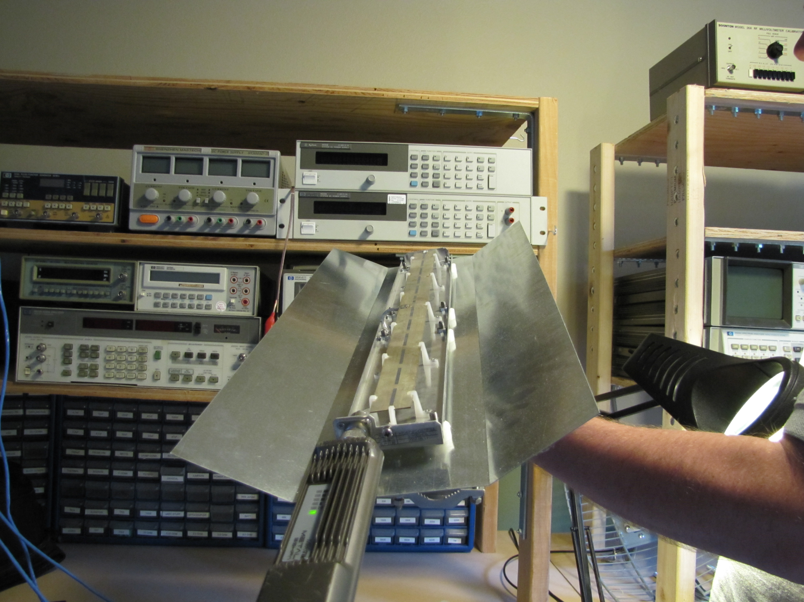
Upcoming Work

Slide 5
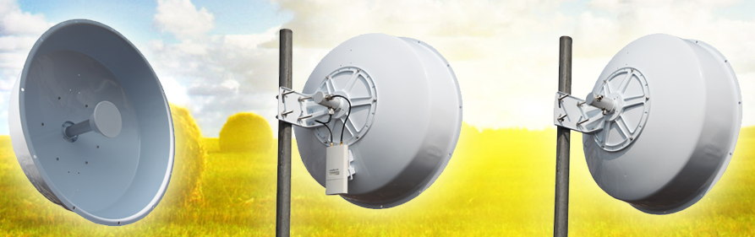
Upcoming Work

Slide 6
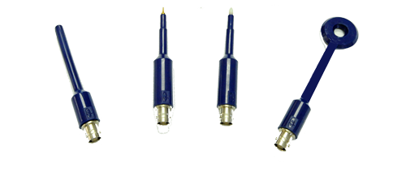
Upcoming Work

Slide 7
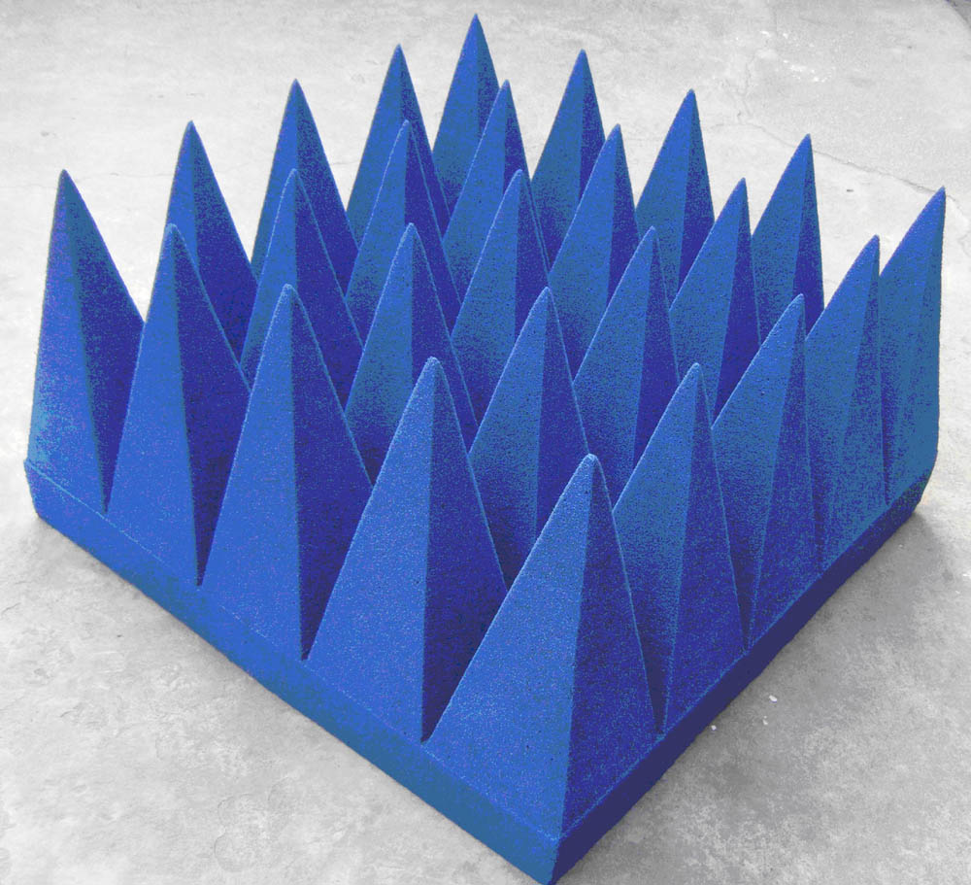
Upcoming Work
Notes:
Z0 = 376 ohms

Slide 8
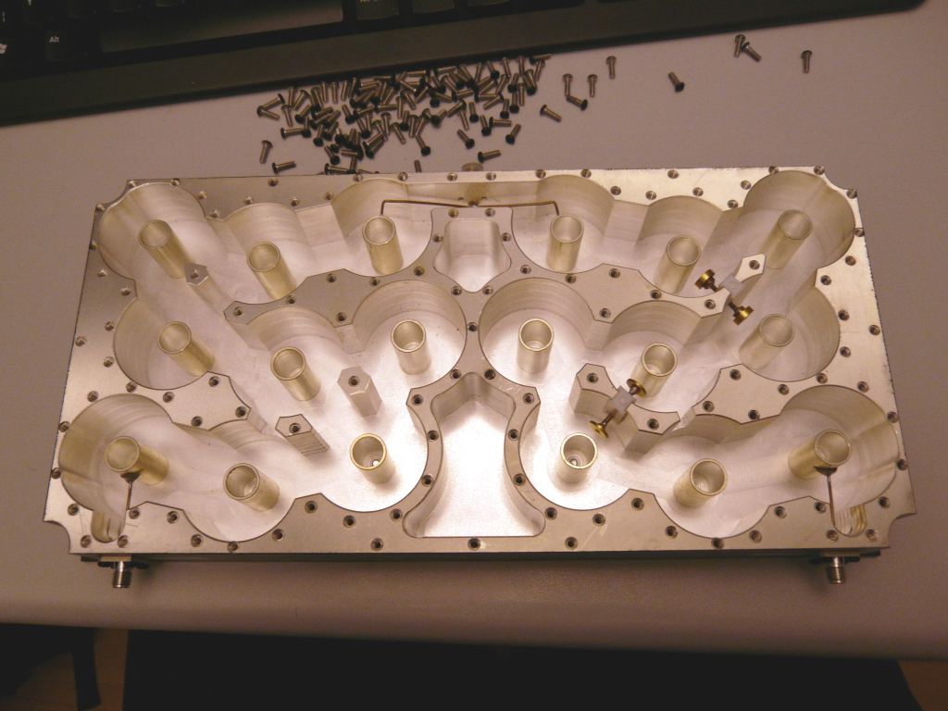
Upcoming Work

Slide 9
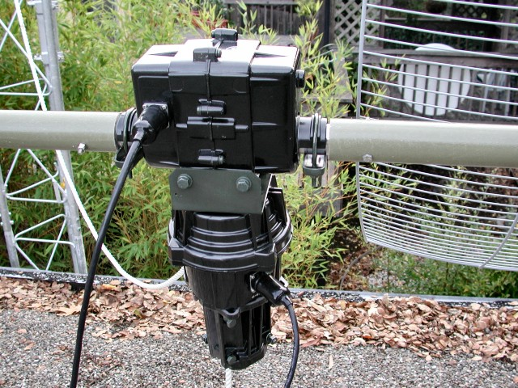
Upcoming Work

Slide 10
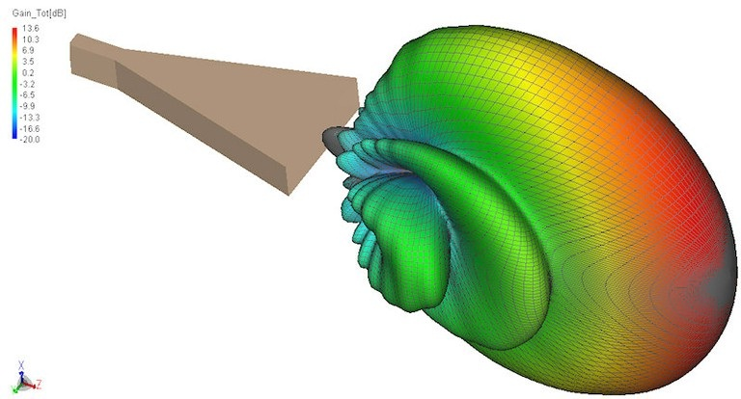
Upcoming Work

Slide 11

Upcoming Work
+48.8dBm @ 6GHz
With 11.1dB gain
And 51% efficiency
For about $120
Anybody have a wire bonder?
TGF2032-2-20

Slide 12
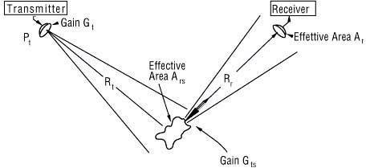
Upcoming Work

Slide 13
Upcoming Work
More software for network automation
More autonomous on-network services
Optimization of network stack
More sites / improved coverage
Better documentation to help others start HamWAN instances elsewhere
Optimize / enable end-user scenarios
Notes:
Services: IRC, Email, Wiki, VoIP, File Storage

Slide 14
Support This!
This project IS the modern frontier of ham radio
Fund this by donating on the website
Recruit engineers and spread the word to talented people about the work being done here
Provide sites to expand the network’s reach
Point other organizations to HamWAN

