Slide 1
Puget Sound Data Ring
Bart Kus – AE7SJ - me@bartk.us
HamWAN.org

Slide 2
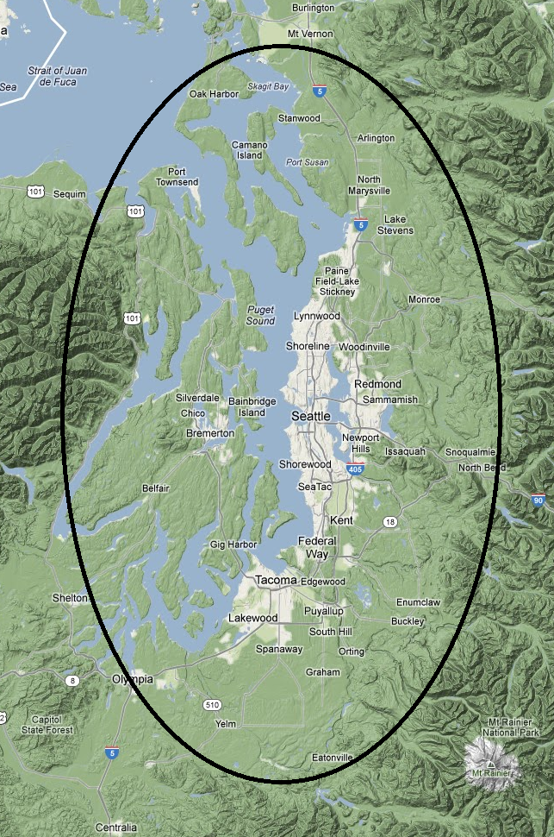

Slide 3
Logical view of network
Uplink Path
Ring Node
Distribution Node
(3-sector)

Slide 5
Why?
Why do you use FM repeaters when you have a cell phone with you?
They connect you to a different community
In a lower pressure way
Do not require contracts or corporations
It’s interesting to play with their features
They’re available when other services fail
Those who build them love the challenge

Slide 6
Why?
Life has advanced into the digital domain
Amateur Radio should be leading technology, not lagging! Remember the early days?
Do I really need to convey the value of all the IP-based software out there?
Telephony
Text messaging
File sharing and everything else!

Slide 7
Why?
Amateurs are in a uniquely good position to be successful at pulling this off!
Leverage existing repeater sites
Existing club infrastructure to rally for the cause
Some existing financial systems to fund it
Access to non-ISM frequencies
Existing expertise in running radio systems
A pool of tech-savvy early adopters / beta testers

Slide 8
Why?
Here’s the future of radio communications, and amateurs can be on the other end of that device

Slide 9
How?
5GHz band
Plenty of spectrum
Easy to achieve spatial diversity
Low atmospheric attenuation
Cheap and available hardware
The Puget Sound has a unique geometry
By using a ring design, coverage comes from all angles – obstacles less of a problem

Slide 10
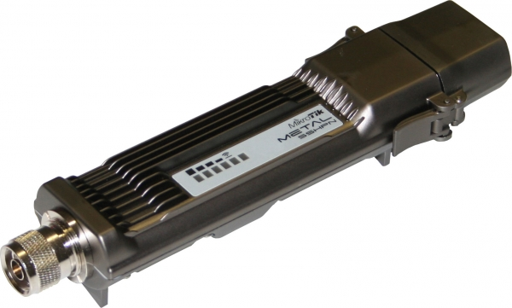
How?
MikroTik - Metal 5SHPn
Up to 115Mbit aggregate
Up to 1.3W transmitter
Solves hidden node problem
Only 11.5W consumption
Only $99
Serious features

Slide 11
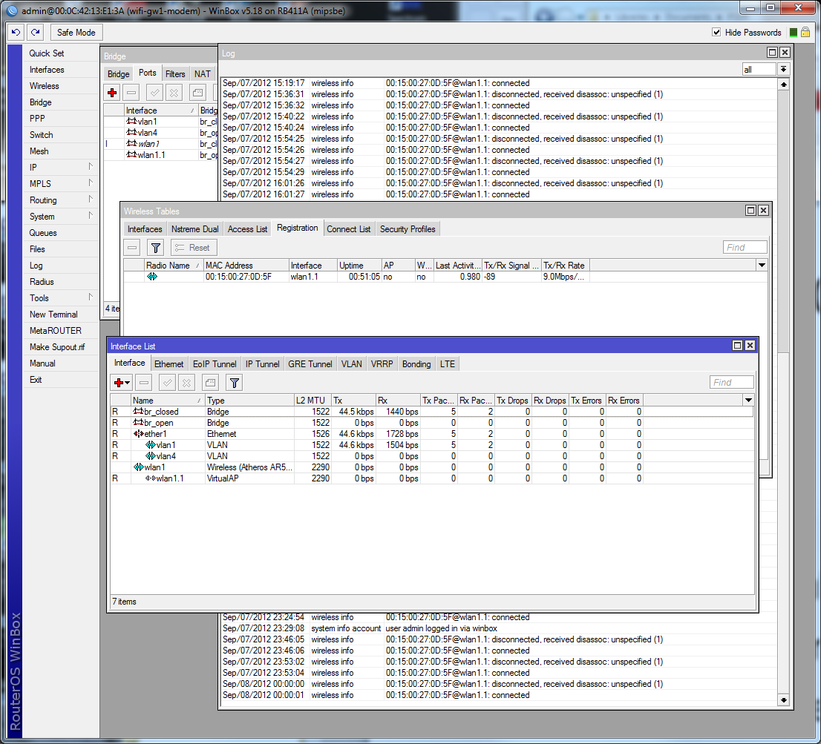
A Sweet Control UI

Slide 12
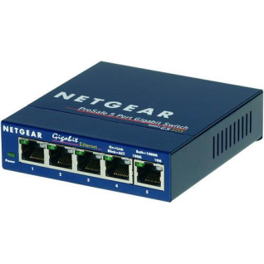
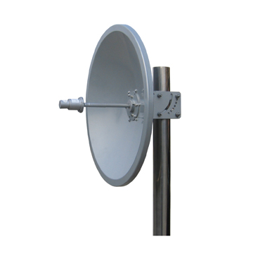
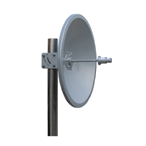
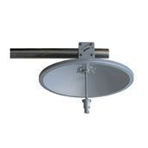
A Typical Ring Node Design
Left Ring
Right Ring
Downlink to Distribution Node
And / Or
Sector Antenna

Slide 13
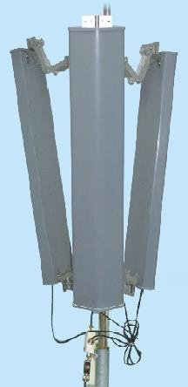
A Typical Distribution Node Design
Ring Uplink
Three 120deg access sectors

Slide 14
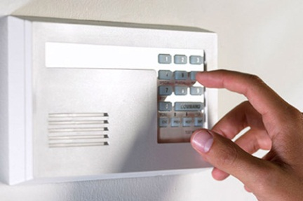
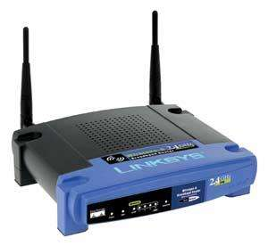
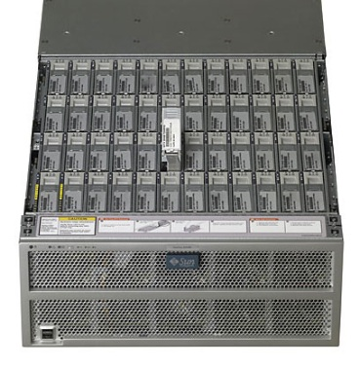
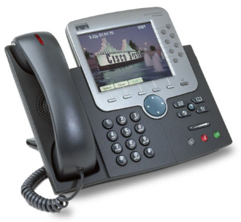
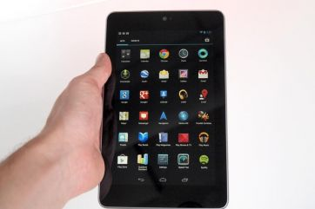
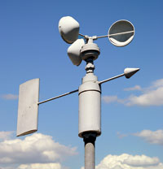
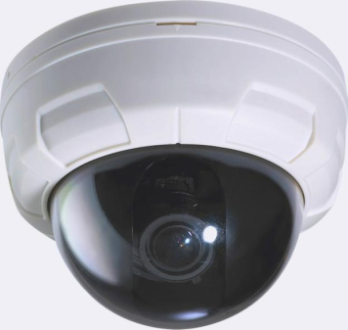
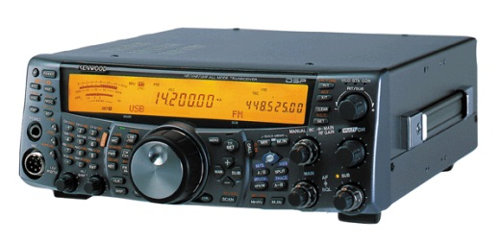
A Typical Client Node Design
Distribution Uplink

Slide 15
A Typical Ring Node Cost
Description | Price | Quantity | Cost
Metal 5SHPn | $99 | 3 | $297
5GHz 28dBi Dish | $75 | 3 | $225
5-port GigE Switch | $40 | 1 | $40
Networked PDU | ~$150 | 1 | $150
CAT5 Cabling | ~$50 | 1 | $50
 |  | TOTAL | $762

Slide 16
A Typical Distribution Node Cost
Description | Price | Quantity | Cost
Metal 5SHPn | $99 | 4 | $396
5GHz 28dBi Dish | $75 | 1 | $75
120deg Sector | $180 | 3 | $540
5-port GigE Switch | $40 | 1 | $40
Networked PDU | ~$150 | 1 | $150
CAT5 Cabling | ~$50 | 1 | $50
 |  | TOTAL | $1251

Slide 17
A Typical Client Node Cost
Description | Price | Quantity | Cost
Metal 5SHPn | $99 | 1 | $99
5GHz 21dBi Dish | $45 | 1 | $45
CAT5 Cabling | ~$10 | 1 | $10
 |  | TOTAL | $154
Other units exist: 16dBi dish integrated with 1.25W TX for $94. Just add CAT5!

Slide 18
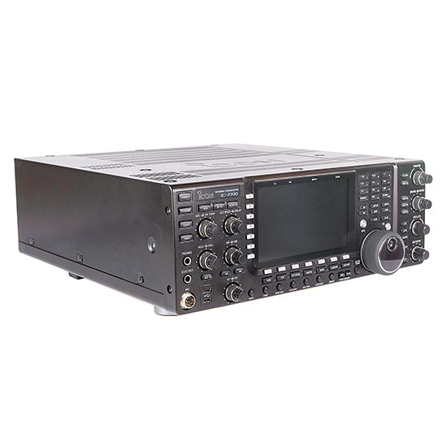
3 Node Ring + Distribution Cost
Description | Price | Quantity | Cost
Ring Node | $762 | 3 | $2286
Distribution Node | $1251 | 3 | $3753
 |  | TOTAL | $6039
That’s less than a single IC-7700 →
And you get to bootstrap the future!

Slide 20
I Want YOU To Help
Scout sites
Donate money
Raise money
Talk to your radio club
Volunteer your expertise
Help deploy equipment
Educate those new to IP

